Slide 1

HBL Gig-Power
A Data-Driven Financial Inclusion Initiative for the Gig Economy

Slide 2


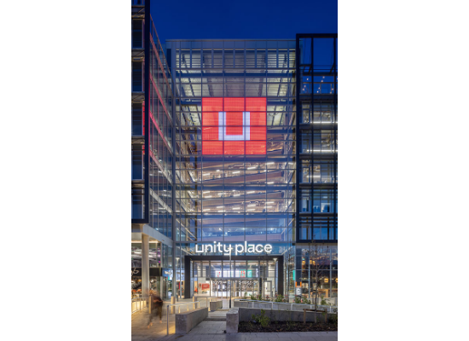
The Evolving Landscape
Traditional Leader vs. Market Gap
HBL is Pakistan's largest multinational bank and the undisputed leader in traditional corporate and salaried banking.
However, the economy is shifting. A $400 Million Gig Economy has emerged. These are young, high-earning professionals who currently have a one-sided relationship with us: we take their deposits, but fail to offer them credit.

Slide 3

The Problem
Meet Ahmed: "Financially Invisible"
Ahmed is a software developer earning $2,500/month (approx. PKR 700k). He is wealthy and responsible.
The Conflict: He wants a car loan, but the loan officer rejects him immediately because he cannot provide a "Salary Slip".
The Result: He moves his funds to Payoneer or Wise. HBL loses a high-value customer because our systems are outdated.

Slide 4



The Market Opportunity
4th
$400M
0
Global Rank
Annual Inflow
Credit Products
Pakistan is the 4th largest freelance market globally.
Foreign exchange contributed by freelancers annually.
Current lending products available for this segment.

Slide 5

The Solution: HBL Gig-Power
Replacing "Paper Documents" with "Digital Data"

Slide 6






The Digital Journey
1. Connect
2. Analyze
3. Offer
User logs in and securely connects their freelance profile (Upwork/Fiverr) via API.
AI scans 12-month remittance history for Consistency, Growth, and Reliability.
System generates a "Gig-Score" and instantly offers a pre-approved Credit Card.

Slide 7
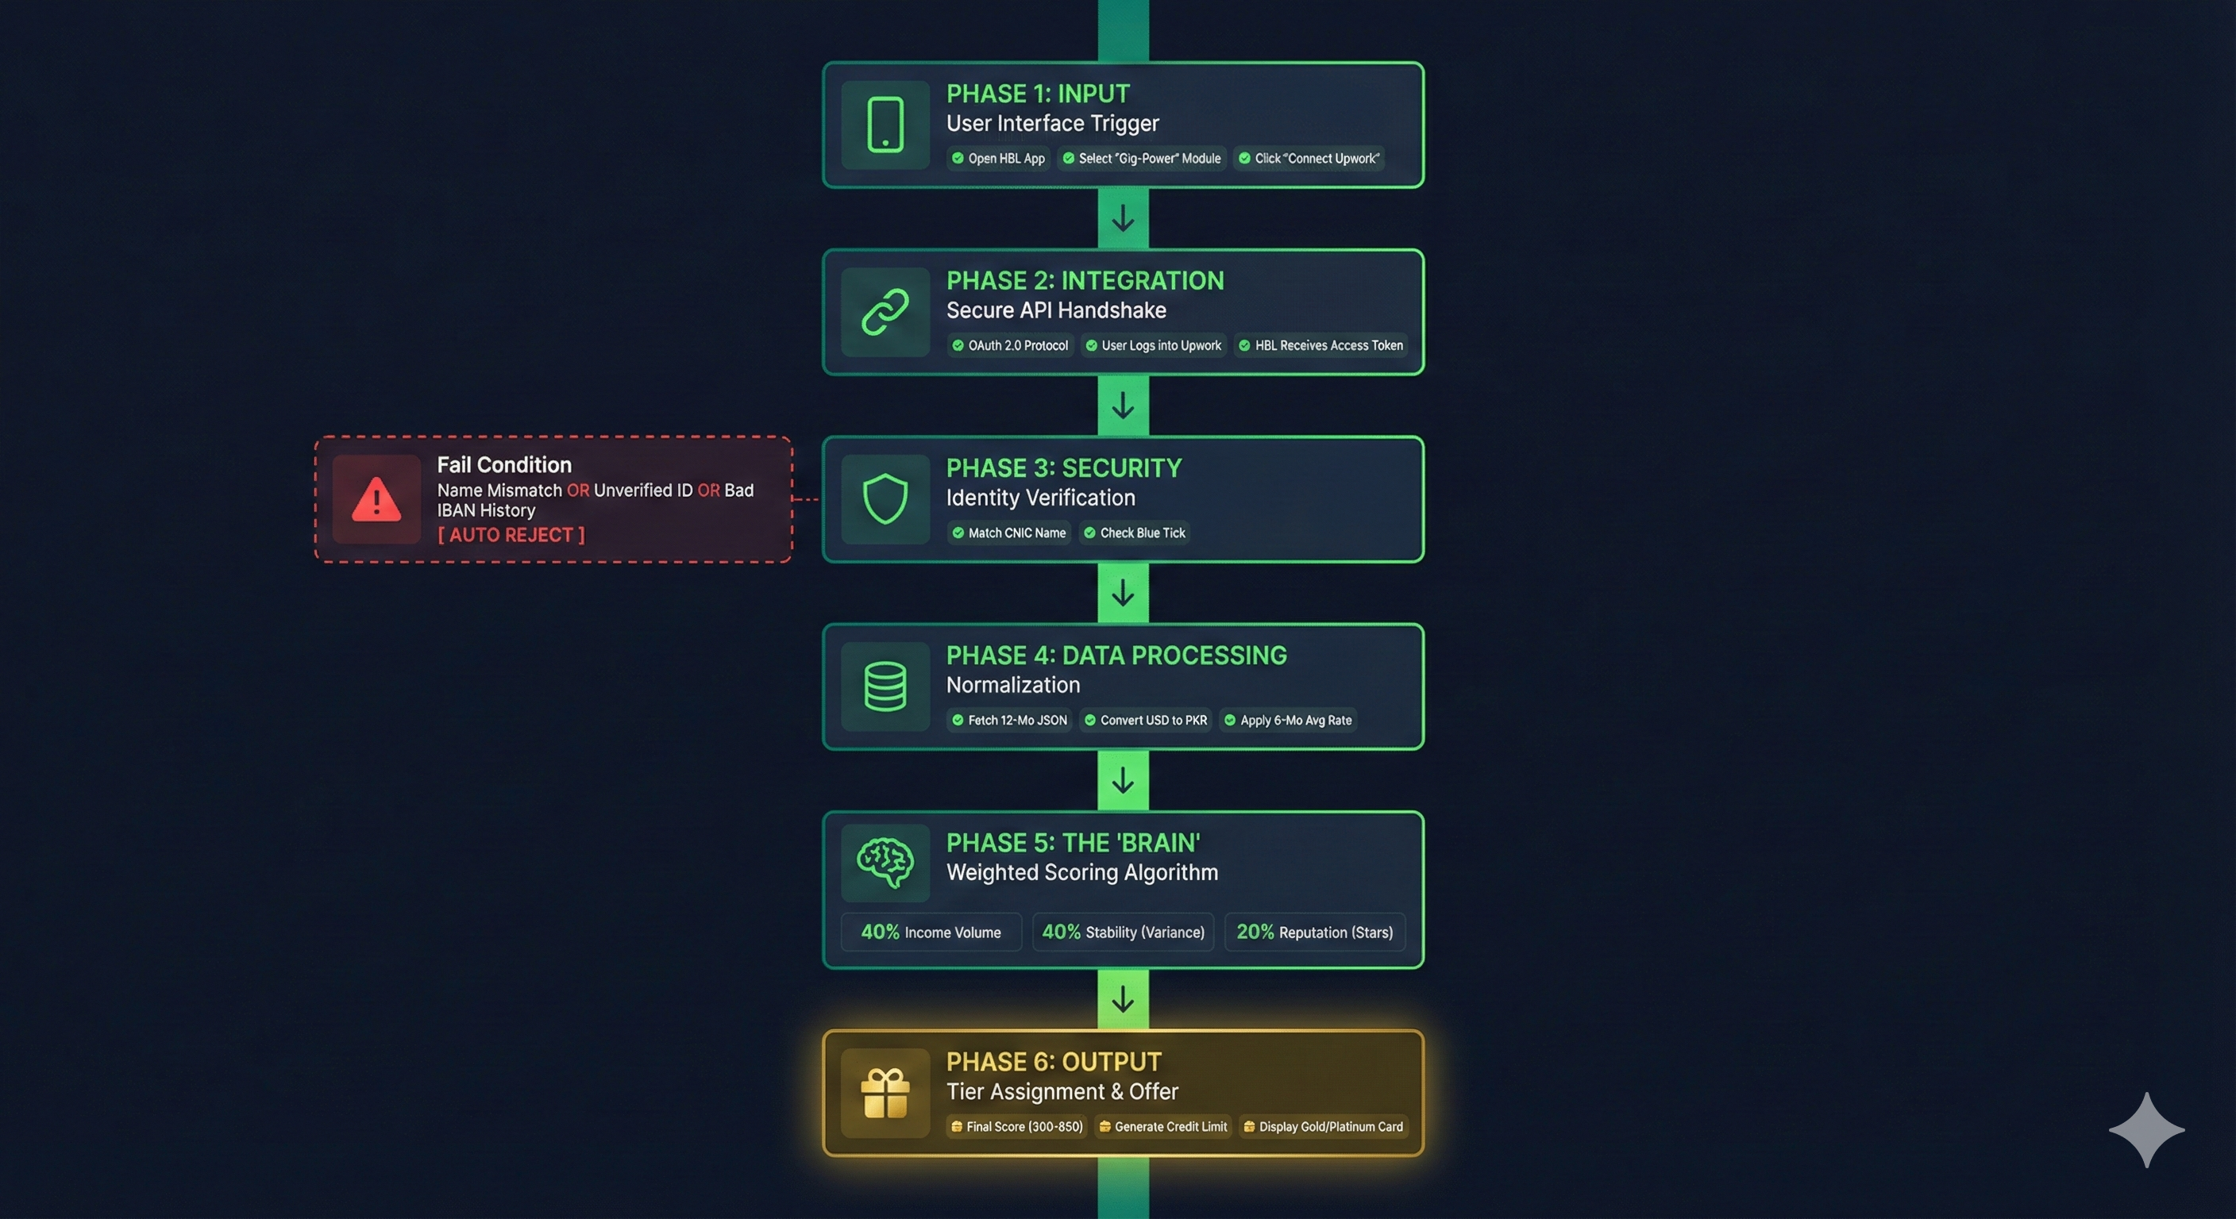

Slide 8
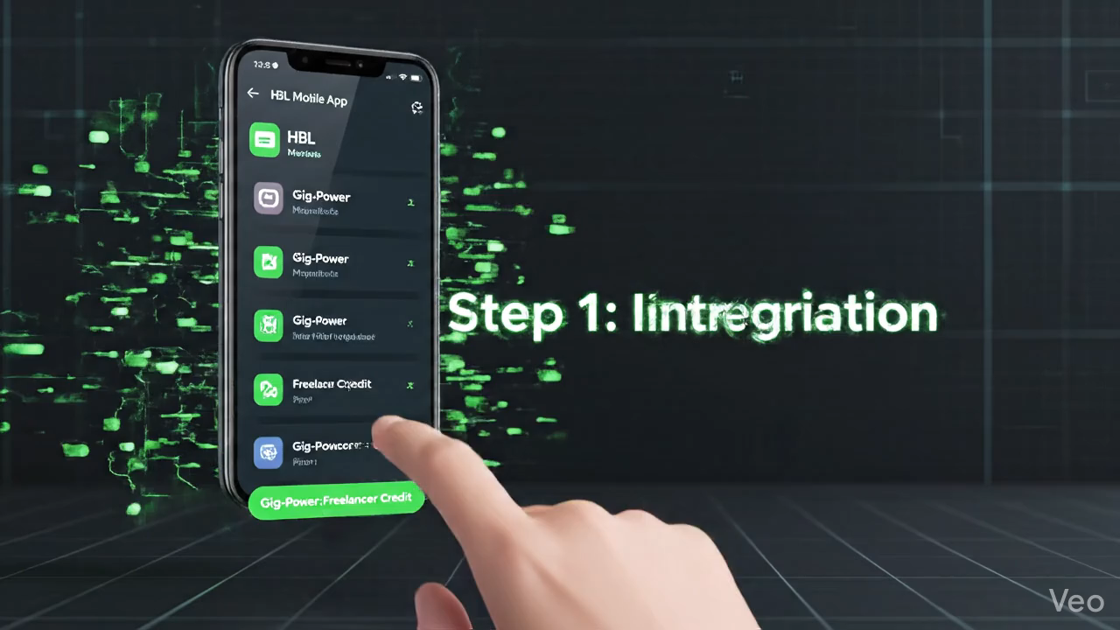

Slide 9

Strategic Goals (SMART)
Year 1 Targets
Alignment & Feasibility
10,000 Active Users Onboarded
Technology: Leveraging existing APIs (Payoneer) to reduce cost.
PKR 100M Total Loan Volume
Vision: Supports SBP's "Financial Inclusion" & HBL's Digital First vision.
< 3% Default Rate (NPL)

Slide 10
Stakeholder Expectations
Stakeholder | Role | Expectation
HBL Management | Sponsor | High ROI and rigorous risk management.
Freelancers | Customers | Dignity, trust, and zero bureaucracy.
State Bank (SBP) | Regulator | Strict AML compliance and data protection.
Remittance Partners | Suppliers | Seamless and secure API data sharing.

Slide 11



Risk Mitigation Strategy
Technical Risk
Business Risk
Ethical Risk
Smart Cache System: Saves scores every 24h to ensure uptime even if APIs go offline.
Dynamic Limits: AI automatically lowers credit limits if income drops for 2 months.
Consent First: Strict Opt-In policy. Data is never sold, only used for scoring.

Slide 12












Project Timeline (6 Months)
M1
M2
M3
M4
M5
M6

Slide 13


The Agile Squad
Team Composition
Muhammad Shahan- Product Lead: Vision & Stakeholder Mgmt.
Syed Noor Hussain Shah - Data Architect: Scoring Logic & Algorithms.
Muhammad Idrees - Risk Officer: SBP Compliance & NPL Control.
Muhammad Amir - UX/UI Designer: App Customer Journey.
Nizar Bahadur - Marketing Strategist: Community Growth.

Slide 14

Resources Required
1M
4
PKR Seed Capital
Months to Beta
Allocated for API Licensing Fees and Initial Digital Marketing Campaign.
Strict timeline to prevent scope creep and ensure we capture market share early.

Slide 15
Questions?
HBL Digital Innovation Unit

